Slide 1
Case Study Real Time Estimation of BOD

Slide 2
Problem: It is difficult to react to high BOD loads in real-time
BOD results, a 5-day lab test, make it challenging for plant operations to adjust treatment processes to adverse levels of BOD real-time.
Symptoms:
The plant does not get timely information when a BOD load comes into the plant from industrial dischargers
Inconsistent responses to incoming load by operators
Not always known when to divert influent to holding tanks
Compliance is sometimes compromised
Notes:
2

Slide 3
Plan: Analyzing the Problem
Plan: Hach WIMS™ correlation tools automatically generate a site specific equation to estimate BOD in real-time based on comparison of Hach UVAS on-line sensor (SCADA data) against lab BOD measurements made with the HQ430 Benchtop meter with the IntelliCAL LBOD probe.
“Our operations department now has access to data that allows them to make adjustments within their operational parameters within hours – not days”
“Monitoring our system continuously has made a big impact on our operational efficiencies and associated costs”
Notes:
3

Slide 4
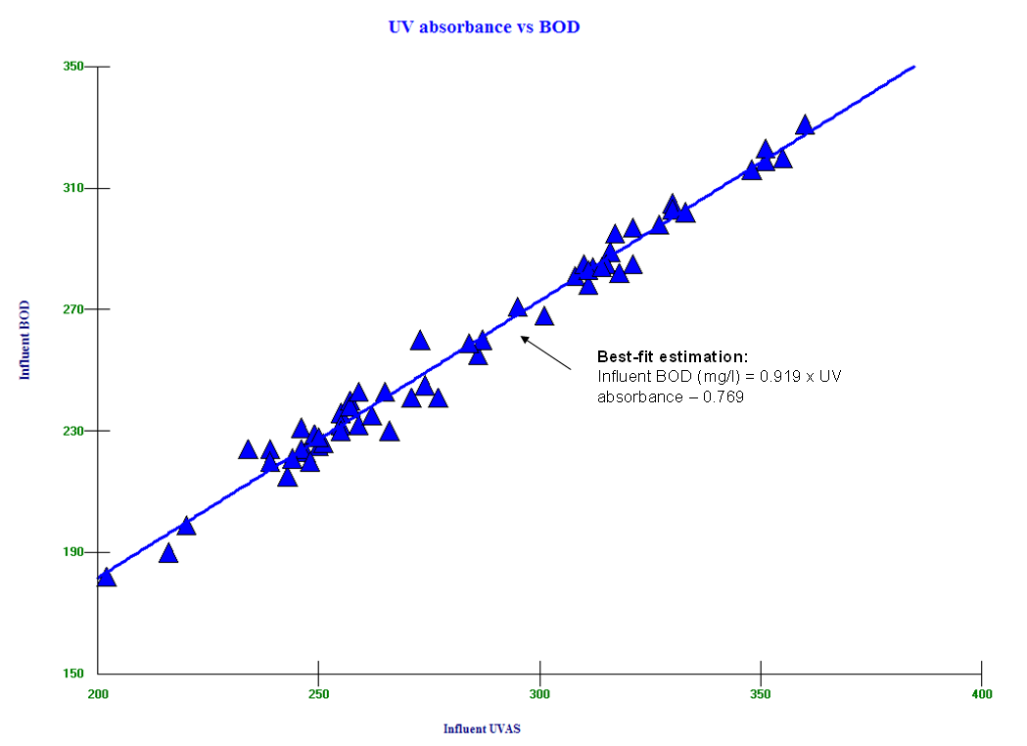
Do: Identify the Problem
Hach WIMS™ correlation tools provide a best fit estimation of influent BOD to UV absorbance and provides a means to predict BOD loading much earlier than the normal 5-day test.
Notes:
4

Slide 5
Check: Sustainability
Best Management Practices say it is not enough to simply identify the problem
and formulate a solution. They must be sustainable to gain maximum benefit!
Import the Hach WIMS correlation equation to your SCADA system and monitor UV to keep on top of incoming BOD loading.
Sustainability is achieved by:
Clearly defining goals
Continuous monitoring to efficiently manage plant operations
Notes:
5

Slide 6
Act: Results and Continuous Improvement
Efficient Management
UVAS readings can now be used confidently to predict BOD
The equation generated by Hach WIMS can be imported into a SCADA system for real time monitoring of the estimated BOD
“Slugs” can now be detected as they come in and can be properly handled
The plant treatment process is protected from high organic loads
Compliance excursions due to unexpected organic loads are minimized
Notes:
6

